Slide 1
Big Data Analytics
Vijayananda J
Sr. Director, Analytics, HISS/HSDP
Philips Healthcare
Aug 2016

Slide 2
Agenda
Lets get the terminologies right
Advice to Students
Ample interactions !

Slide 3
Terminologies
Big Data
Analytics
Machine learning
Cloud computing
IoT

Slide 4
Big Data
Definition
Data sets that are “very” big
10 years back a GB was considered as big. Today TB is not considered “big data” [can hold in a USB drive]
Traditional data processing apps are inadequate
Challenges are many
Ingestion – Multiple data sources
Store – Multiple levels – Archive, Persistent store, Disk, SSDs, Memory
Search – indexing
Visualization - huge dimensions
Privacy – esp. Patient data
Provenance – To avoid sleepless nights
Processing
Pipeline
Distributed
Linear Scaled

Slide 5
Analytics
How can we
make it happen ?
Prescriptive Analytics
What will
happen ?
Predictive Analytics
Foresight
What is happening now ?
Advanced
Analytics
Operational Analytics
Why did it
happen ?
Insight
Value
Diagnostic Analytics
What
happened ?
Descriptive Analytics
Basic Analytics
Hindsight
Difficulty
Notes:
Prescriptive analytics not only anticipates what will happen and when it will happen, but also why it will happen.
Further, prescriptive analytics suggests decision options on how to take advantage of a future opportunity or mitigate a future risk
It shows the implication of each decision option.
Prescriptive analytics can continually take in new data to re-predict and re-prescribe, thus automatically improving prediction accuracy and prescribing better decision options.

Slide 6
What is ML ?
Machine learning systems automatically learn programs from data.
Traditional programing
Data
Computer
Output
Algorithm
Machine Learning
Data
Computer
Algorithm
Output

Slide 7
Machine Learning
Types
Supervised learning
Unsupervised learning
Semi supervised learning
Reinforcement learning

Slide 8
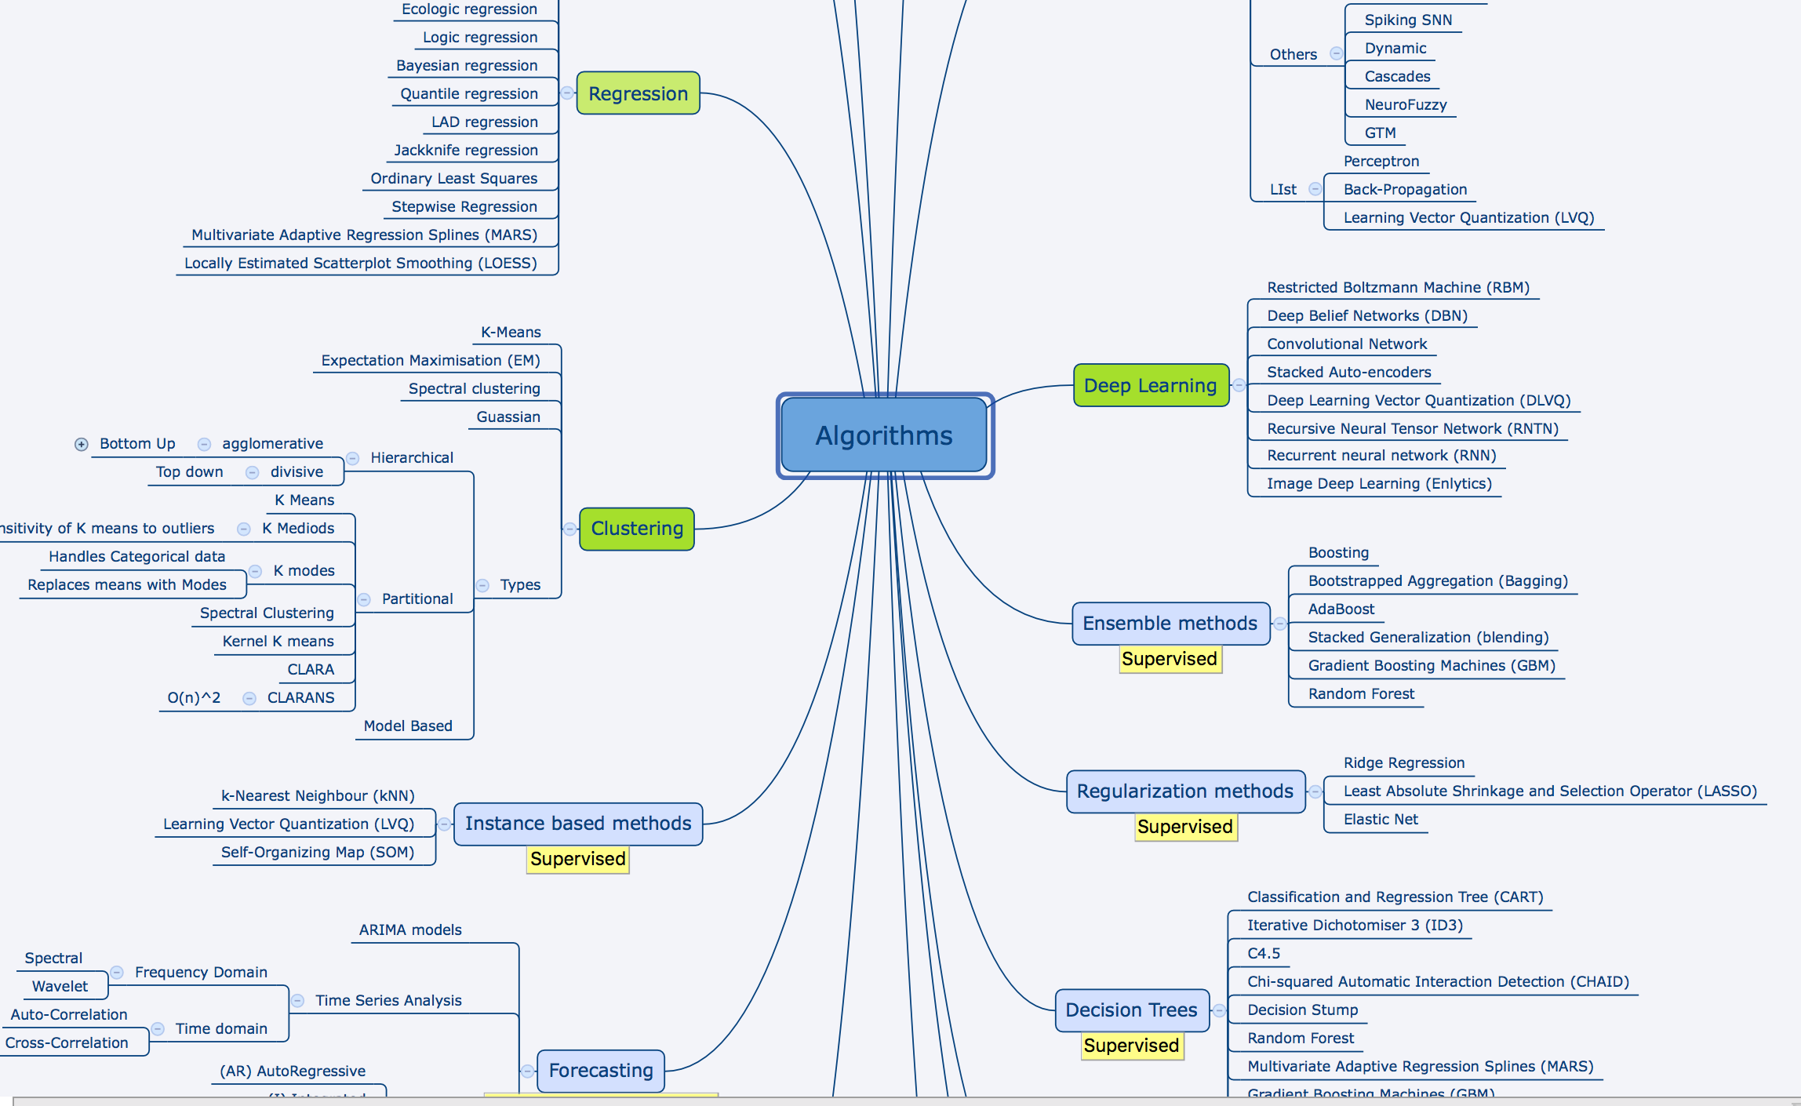
Algorithms
Representative list

Slide 9
Cloud computing
Think of a server that is kept in a remote location
Key aspects
No maintenance
Elasticity
Pay per use
Clear separation of Compute, Store and Memory
Compute – CPU/GPU
Store – Archive, Disk (multiple types)
Memory – size
Multi-tenancy
Challenges
Security
Performance
Legal

Slide 10
IoT

Slide 11
Tools and Techniques
Hadoop ecosystem
HDFS, Hbase, ZK,…
Streaming
Kafka, RMQ, Spark Streaming....
DataWarehouse
Hive, Kylin, Lens, Druid
Resource scheduling and Processing frameworks
Spark, Yarn, Mesos,....
Cloud computing
AWS, GCE, Azure,...
ML
MLLib, H20, PMML,....
Vendors
Cloudera, Hwx, MapR, DataBricks, H20...

Slide 12
So what are you thinking ?
There are 1000s of free resources and books available to learn
Hadoop, Spark, AWS…....
100s of technologies and
1000s of Vendors in this space
No. Dont ever do that...you will never win!
Go to Basics and get your foundations strong....
Now is the opportunity to reinforce your 12th foundations and build on top of it...

Slide 13
Big data and Analytics – a Holistic approach
Big Data
operations
Deployment
Architecture

Slide 14
Examples of great foundations
Dams
Spend more than 50% of effort in the foundations
Any great visionary in Analytics
Andrew Ng, Yan LeCunn, Geff Hilton…. Solid educational background...
Sanskrit scholars
Strong foundation on Grammar, Logic
Works (Kaavya, Nataka,..) are like apps

Slide 15
Advice for students
Master the fundamentals
E.g. windows and linux – Learn OS fundamentals
Persistent stores
Understand key concepts in stores – Latency, access mechanisms…
Processing
Compute and data affinity (Run code where data is present)
Data ware houses
Relational, Object, NoSQL
ML
Stats, Probability, maths (LA, Calculus, search algorithms...)

Slide 16
Advice to students -
Do this … Whenever you have time
Participate in Competitions
Kaggle
Answer questions in forums
Quora
Watch TED talks
Listen to talks by luminaries
E.g. Gilbert Strang, Pedro Domingo…
Read top notch papers
Archive.Org, MS research labs
Subscribe to tweets from achievers
Attend conferences
By submitting papers !
Contribute to Open source communities
Eat, Drink, sleep ... Python and R

Slide 17
Suggestions for faculty
Host conferences
Have specific topics – Real time Analytics, AI etc.
Encourage students to submit papers in journals/conferences
Subscribe to virtual cloud set up – Install PyNB, Rstudio – provide dev env.
Make data sets available to the student/research community
Tons of public data available
Take data sets from KMC- Anonymise them and make it available for students to play around
(This itself will also ensure that there is a Big data platform).
Collaborations with industry will expedite your research work
Conduct hackathons
Arrange for invited talks from experts in the academics/research and Industry.
Excellent way to learn and keep abreast with Technologies and thier applicability

Slide 19
Data Sets
https://www.foreignlaborcert.doleta.gov/performancedata.cfm
http://archive.ics.uci.edu/ml/
https://news.upenn.edu/news/penn-researchers-use-facebook-data-predict-users-age-gender-and-personality-traits
https://aws.amazon.com/public-data-sets/
https://www.quandl.com/
http://data.worldbank.org/
http://data.gov.in/opendatasites

